Slide 1
Uncertainty Quantification of Cantilever Wing Natural Frequencies
By Daniel Clark
And
Admir Makas

Slide 2
Overview
Introduction
FE Model Set-up
RVs Definitions
Analysis Overview
Results
Questions

Slide 3
Introduction
In aerospace applications, components such as wings will have inherent variability due to following parameters:
Material variability:
Young’s Modulus
Density
Poisson’s Ratio
Dimensional variability:
Span/Length
Chord
Thickness
Attachment rigidity
Other (external tanks, munitions, fuel levels, flight conditions, etc…)
Variables mentioned above will impact dynamic response of the wing, which can have profound effects on fatigue performance and flutter characteristics of the wing design.
5 random variables chosen for analysis

Slide 4
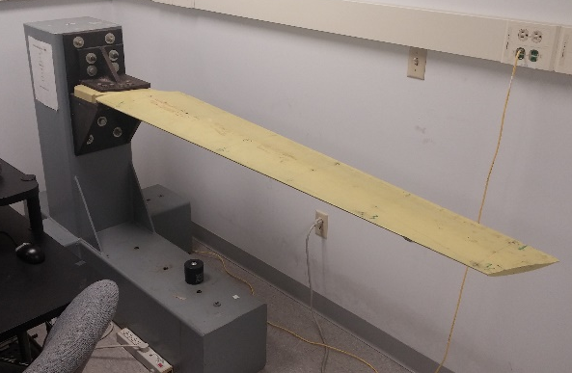
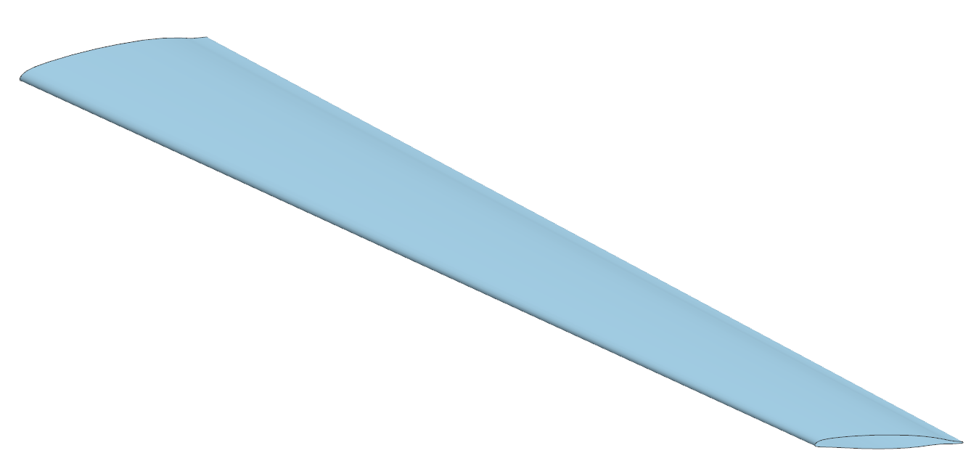
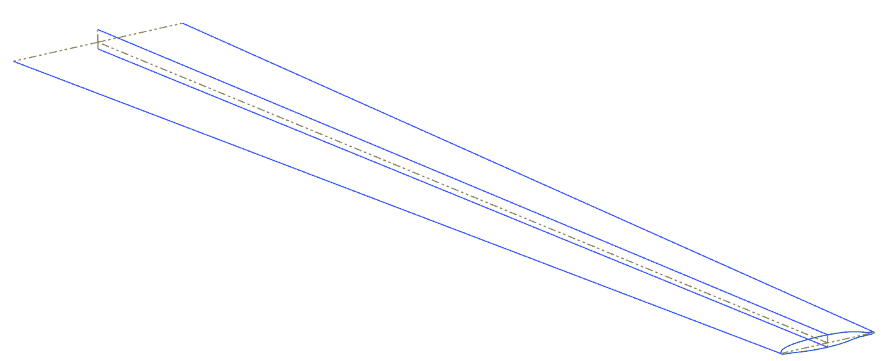
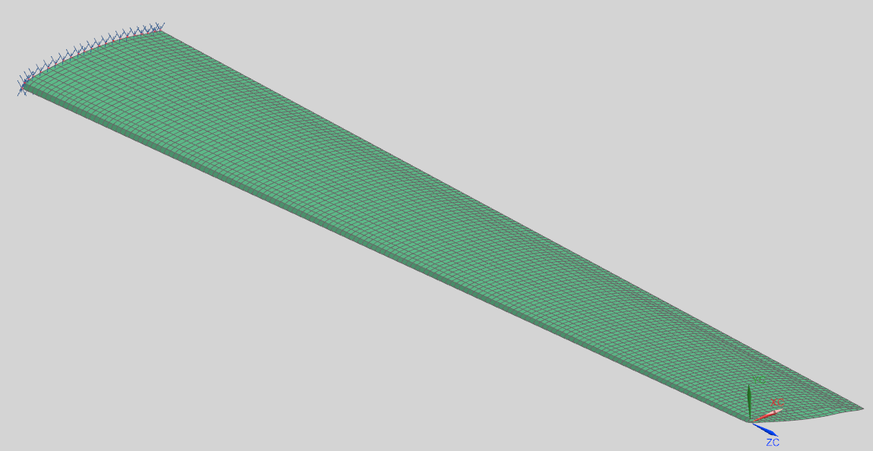
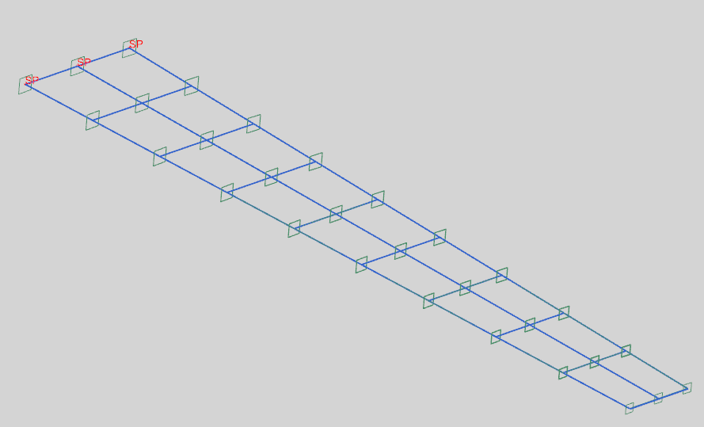



FE Model Details
Cantilever wing from the vibrations lab was chosen for the uncertainty study because experimental data is already available.
Hand measurements used to obtain model geometry
CAD
Mass ≈ 12.84 kg
Model Info:
Nodes = 830
CQUAD = 660
Material = Al
E = 75 GPa , υ = 0.33, ρ = 2700 $\frac{kg}{m^{3}}$
 | Modes (Hz) | Modes (Hz) | Error %
1 | 13.5 | 11.92 | 11.70
2 | 51.7 | 57.9 | 11.99
3 | 124.7 | 140.33 | 12.53
4 | 167.38 | 160.27 | 4.25
5 | 228.25 | 248.13 | 8.71
 | Experiment | Simulation
Shell Model
RUN TIME
≈ 3.0 sec
NASTRAN
Mass ≈ 12.80 kg
Model Info:
Nodes = 33
CBEAM = 30
Material = Al
E = 75 GPa , υ = 0.33, ρ = 2700 $\frac{kg}{m^{3}}$
 | Modes (Hz) | Modes (Hz) | Error %
1 | 13.5 | 12.24 | 9.33
2 | 51.7 | 55.53 | 7.41
3 | 124.7 | 137.37 | 10.16
4 | 167.38 | 187.1 | 11.78
5 | 228.25 | 255.3 | 11.85
 | Experiment | Simulation
RUN TIME
≈ 1.0 sec
Beam Model
NASTRAN

Slide 5
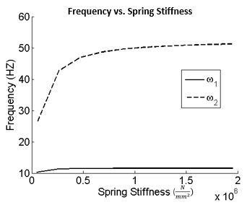
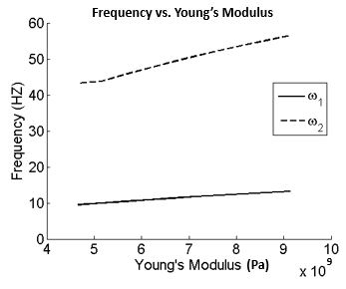
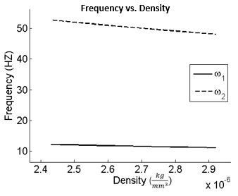
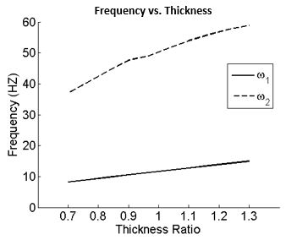
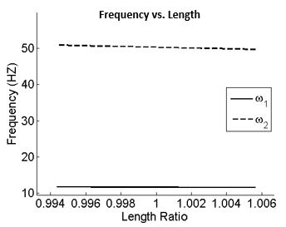
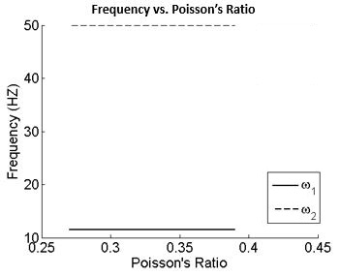

Design Sensitivity With Respect to RV’s
Model response to six RV’s was investigated.
Five out of the six RV’s were kept for uncertainty studies.
Higher modes are more sensitive to RV variation.

Slide 6
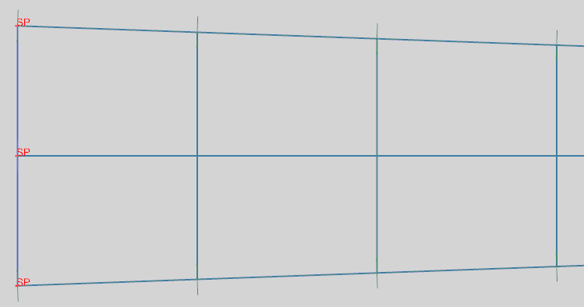
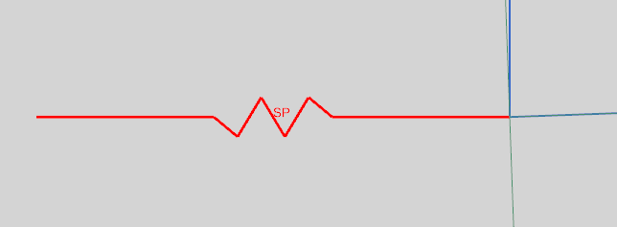
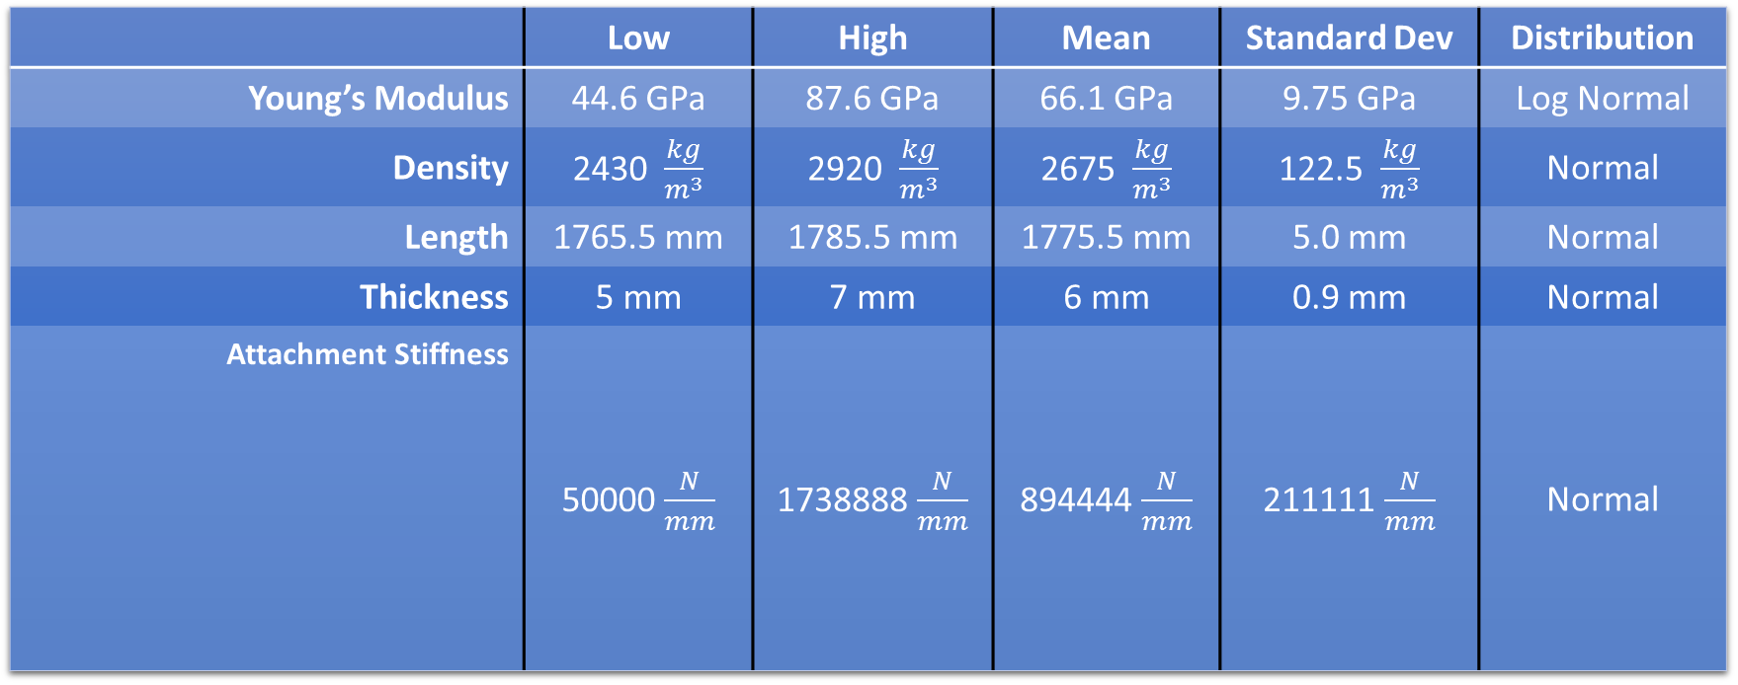
Random Variable Definitions
Remaining five variables are listed in table below:
Variable limits were determined by available material data and prior knowledge.
Effects of Poisson’s ratio were evaluated and found to be insignificant during the sensitivity study phase.
 | Low | High | Mean | Standard Dev | Distribution
Young’s Modulus | 44.6 GPa | 87.6 GPa | 66.1 GPa | 9.75 GPa | Log Normal
Density | 2430 $\frac{kg}{m^{3}}$ | 2920 $\frac{kg}{m^{3}}$ | 2675 $\frac{kg}{m^{3}}$ | 122.5 $\frac{kg}{m^{3}}$ | Normal
Length | 1765.5 mm | 1785.5 mm | 1775.5 mm | 5.0 mm | Normal
Thickness | 5 mm | 7 mm | 6 mm | 0.9 mm | Normal
Attachment Stiffness | 50000 $\frac{N}{mm}$ | 1738888 $\frac{N}{mm}$ | 894444 $\frac{N}{mm}$ | 211111 $\frac{N}{mm}$ | Normal
CBUSH elements used to simulate boundary stiffness

Slide 7
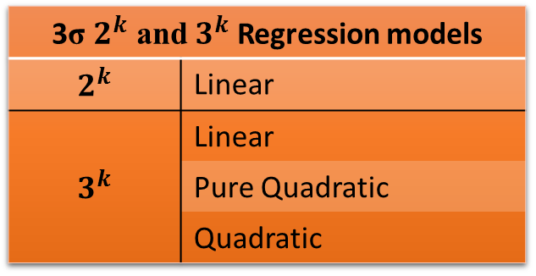
Analysis Details
Wing is assumed to operate at 35 Hz frequency.
Goal of the reliability analysis is to determine the probability of 2nd natural frequency becoming less than 35 Hz.
Following analysis was conducted:
Analysis | # of Samples | Notes
Monte Carlo | 64630 | Considered Truth
LHS | 10 100 500 1000 2000 5000 8000 10000 20000 30000 | Used to build Kriging surrogate models
3σ $2^{k}$ and $3^{k}$ Regression models
$$2^{k}$$ | Linear
$$3^{k}$$ | Linear
 | Pure Quadratic
 | Quadratic

Slide 8
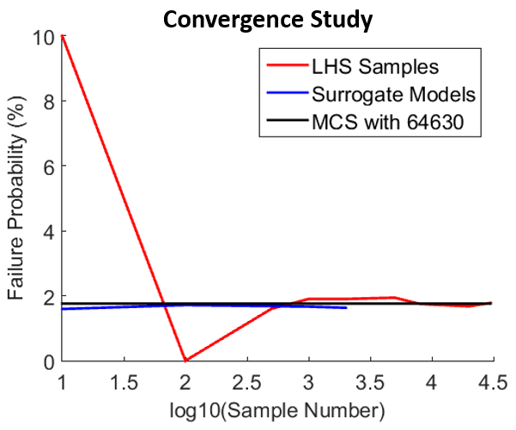
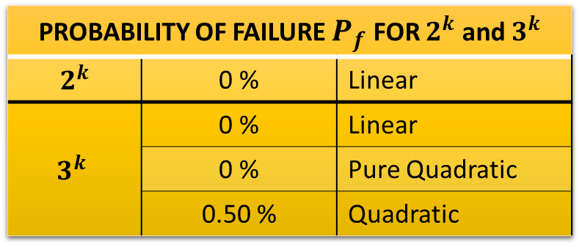
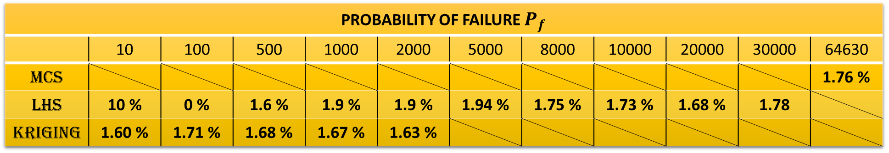
Results
PROBABILITY OF FAILURE $P_{f}$
 | 10 | 100 | 500 | 1000 | 2000 | 5000 | 8000 | 10000 | 20000 | 30000 | 64630
MCS |  |  |  |  |  |  |  |  |  |  | 1.76 %
LHS | 10 % | 0 % | 1.6 % | 1.9 % | 1.9 % | 1.94 % | 1.75 % | 1.73 % | 1.68 % | 1.78
Kriging | 1.60 % | 1.71 % | 1.68 % | 1.67 % | 1.63 %
PROBABILITY OF FAILURE $P_{f}$ FOR $2^{k}$ and $3^{k}$
$$2^{k}$$ | 0 % | Linear
$$3^{k}$$ | 0 % | Linear
 | 0 % | Pure Quadratic
 | 0.50 % | Quadratic

Slide 9

QUESTIONS ???

